Slide 1
Connecting React to External Services

Slide 2
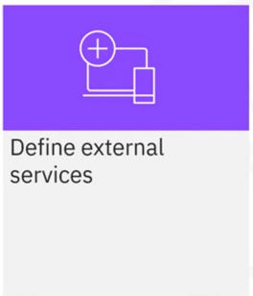
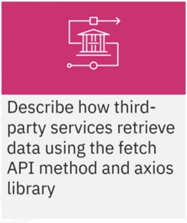
What you will learn

Slide 3


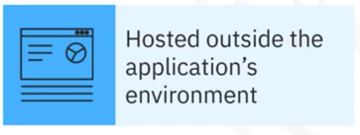

What are external services

Slide 4
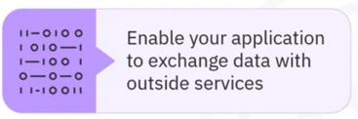



Application programming interfaces(APIs)

Slide 5
API fetch method
Axios
A popular JavaScript Library used for making HTTP requests from web browsers

Slide 6
Recap
In this video, you Learned that:
• External services are any program, platform, or infrastructure
your application uses to connect to and work with other
applications over a network
• APIs enable you to acquire data, execute operations, or add
extra features to your application
• Third-party services provide data you can retrieve using
multiple API methods, such as fetch API method and axios
Library

